Slide 1




PDS
Computer Vision
Chapter 4:
Tips for Deep Learning
https://github.com/siagianp
https://github.com/amelcharolinesgn2/IoT_simulator-mqtt-NodeRed
https://www.youtube.com/@AmelOline/videos
Notes:
https://medium.com/buildpiper/simplifying-containerization-with-docker-run-command-2f74e114f42a
https://github.com/IBA-Group-IT/IoT-data-simulator
https://www.bevywise.com/blog/docker-mqtt-broker-easy-service-manageability/

Slide 2

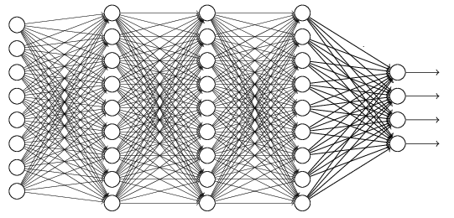
Recipe of Deep Learning
YES
Step 1: define a set of function
Step 2: goodness of function
Step 3: pick the best function
NO
Good Results on Testing Data?
Overfitting!
YES
NO
Good Results on Training Data?
Neural Network
Notes:
Other methods do not emphasize this.
Some machine learning methods do not emphasize this.

Slide 3
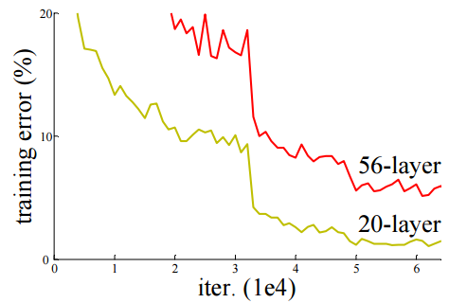
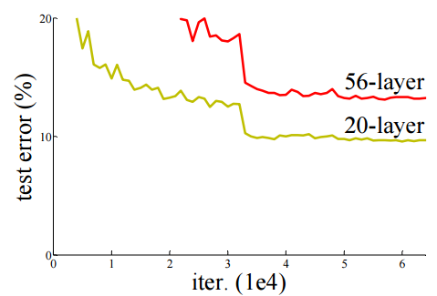

Do not always blame Overfitting
Not well trained
Overfitting?
Training Data
Testing Data
Deep Residual Learning for Image Recognition
http://arxiv.org/abs/1512.03385

Slide 4
Recipe of Deep Learning
YES
Good Results on Testing Data?
Different approaches for different problems.
YES
e.g. dropout for good results on testing data
Good Results on Training Data?
Neural Network
Notes:
加敏 加防

Slide 5
Recipe of Deep Learning
Regularization
Early Stopping
Dropout
YES
Good Results on Testing Data?
Adaptive Learning Rate
New activation function
YES
Good Results on Training Data?

Slide 6
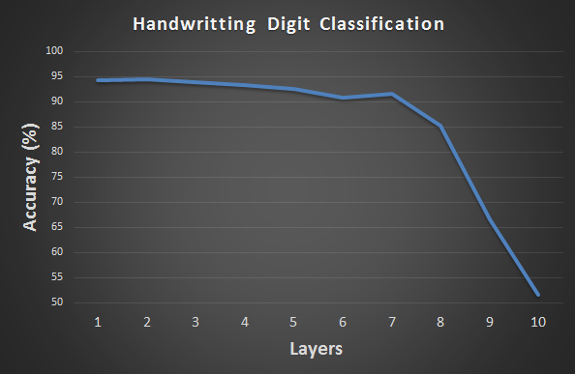
Hard to get the power of Deep …
Results on Training Data
Deeper usually does not imply better.
Notes:
感不感獎 時投湯 的故是

Slide 7
Vanishing Gradient Problem
……
y₁
……
y₂
……
……
……
……
……
……
y_{M}
Smaller gradients
Larger gradients
Learn very slow
Learn very fast
Almost random
Already converge
based on random!?
Notes:
The problem of gradient vanish is very hard to explain ……………….!!!!!!!!!!!!!!!!!!!!!!!!!!!!!!!!!
石頭湯裡的石頭
See Gradient flow in recurrent nets: the difficulty of learning long-term dependencies, by Sepp Hochreiter, Yoshua Bengio, Paolo Frasconi, and Jürgen Schmidhuber (2001). This paper studied recurrent neural nets, but the essential phenomenon is the same as in the feedforward networks we are studying. See also Sepp Hochreiter's earlier Diploma Thesis,Untersuchungen zu dynamischen neuronalen Netzen (1991, in German).
Stuck at a bad local minima
When deep learning is difficult in early year
Need initialization
Another point of view
Definition of gradient

Slide 8
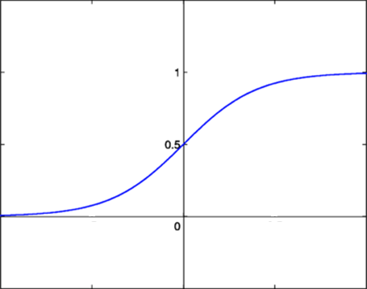




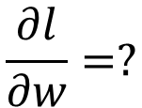






Vanishing Gradient Problem
Smaller gradients
……
$$y_{1}$$
$${\hat{y}}_{1}$$
Small output
……
$$y_{2}$$
$${\hat{y}}_{2}$$
……
……
……
……
……
$$l$$
……
$$+∆l$$
……
$$y_{M}$$
$${\hat{y}}_{M}$$
Large input
$$+∆w$$
Intuitive way to compute the derivatives …
$$\frac{∂l}{∂w}=?$$
$$\frac{∆l}{∆w}$$

Slide 9





ReLU
Rectified Linear Unit (ReLU)
Reason:
$$a$$
$$σ\left(z\right)$$
1. Fast to compute
$$a=z$$
2. Biological reason
$$a=0$$
3. Infinite sigmoid with different biases
$$z$$
4. Vanishing gradient problem
[Xavier Glorot, AISTATS’11]
[Andrew L. Maas, ICML’13]
[Kaiming He, arXiv’15]
Notes:
Parametric ReLU, -> PReLU
Ref: Glorot, Xavier, Antoine Bordes, and Yoshua Bengio. "Deep sparse rectifier neural networks." International Conference on Artificial Intelligence and Statistics. 2011.
No differentailalbe how about 0
Benefit:
2011
Where does it come from?
fast to compute
biology?
many sigmoid

Slide 10
ReLU
$$a$$
$$a=z$$
$$a=0$$
$$z$$
0
0
0
0

Slide 11
ReLU
$$a$$
$$a=z$$
A Thinner linear network
$$a=0$$
$$z$$
Do not have smaller gradients

Slide 12




ReLU - variant
$$Leaky ReLU$$
$$Parametric ReLU$$
$$a$$
$$a$$
$$a=z$$
$$a=z$$
$$z$$
$$z$$
$$a=0.01z$$
$$a=αz$$
α also learned by gradient descent

Slide 13












Maxout
ReLU is a special cases of Maxout
Learnable activation function [Ian J. Goodfellow, ICML’13]
+
neuron
+
$$5$$
$$1$$
Input
Max
$$7$$
Max
$$2$$
+
$$7$$
+
$$2$$
+
$$−1$$
+
$$4$$
Max
$$1$$
Max
$$4$$
+
$$1$$
+
$$3$$
You can have more than 2 elements in a group.
Notes:
How to train? Latter
2013
Ian J. Goodfellow goodfeli@iro.umontreal.ca David Warde-Farley wardefar@iro.umontreal.ca Mehdi Mirza mirzamom@iro.umontreal.ca Aaron Courville aaron.courville@umontreal.ca Yoshua Bengio

Slide 14











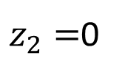







Maxout
ReLU is a special cases of Maxout
+
$$z_{1}^{}$$
$$z$$
ReLU
Input
$$w$$
$$a$$
Input
$$w$$
Max
$$b$$
$$a$$
$$0$$
+
$$z_{2}^{}$$
$$max\left\{z_{1}^{},z_{2}^{}\right\}$$
$$b$$
$$0$$
$$a$$
$$a$$
$$z=wx+b$$
$$z_{1}=wx+b$$
$$x$$
$$x$$
$z_{2}=$0

Slide 15



Maxout
More than ReLU
+
$$z_{1}^{}$$
$$z$$
ReLU
Input
$$w$$
$$a$$
Input
$$w$$
Max
$$b$$
$$a$$
+
$$z_{2}^{}$$
$$w^{′}$$
$$max\left\{z_{1}^{},z_{2}^{}\right\}$$
$$b$$
$$b^{′}$$
Learnable Activation Function
$$a$$
$$a$$
$$z=wx+b$$
$$z_{1}=wx+b$$
$$x$$
$$x$$
$$z_{2}=w^{′}x+b^{′}$$

Slide 16
Maxout
Learnable activation function [Ian J. Goodfellow, ICML’13]
Activation function in maxout network can be any piecewise linear convex function
How many pieces depending on how many elements in a group
2 elements in a group
3 elements in a group
Notes:
3,4,5

Slide 17
















Maxout - Training
Given a training data x, we know which z would be the max
+
$$z_{1}^{1}$$
+
$$z_{1}^{2}$$
Input
Max
$$a_{1}^{1}$$
Max
$$a_{1}^{2}$$
+
$$z_{2}^{1}$$
+
$$z_{2}^{2}$$
$$max\left\{z_{1}^{1},z_{2}^{1}\right\}$$
+
$$z_{3}^{1}$$
+
$$z_{3}^{2}$$
Max
$$a_{2}^{1}$$
Max
$$a_{2}^{2}$$
$$x$$
+
$$z_{4}^{1}$$
$$a^{1}$$
+
$$z_{4}^{2}$$
$$a^{2}$$

Slide 18
Maxout - Training
Given a training data x, we know which z would be the max
Train this thin and linear network
+
$$z_{1}^{1}$$
+
$$z_{1}^{2}$$
Input
$$a_{1}^{1}$$
$$a_{1}^{2}$$
+
$$z_{2}^{1}$$
+
$$z_{2}^{2}$$
+
$$z_{3}^{1}$$
+
$$z_{3}^{2}$$
$$x$$
$$a_{2}^{1}$$
$$a_{2}^{2}$$
+
$$z_{4}^{1}$$
$$a^{1}$$
+
$$z_{4}^{2}$$
$$a^{2}$$
Different thin and linear network for different examples

Slide 19
Recipe of Deep Learning
Regularization
Early Stopping
Dropout
YES
Good Results on Testing Data?
Adaptive Learning Rate
New activation function
YES
Good Results on Training Data?

Slide 20
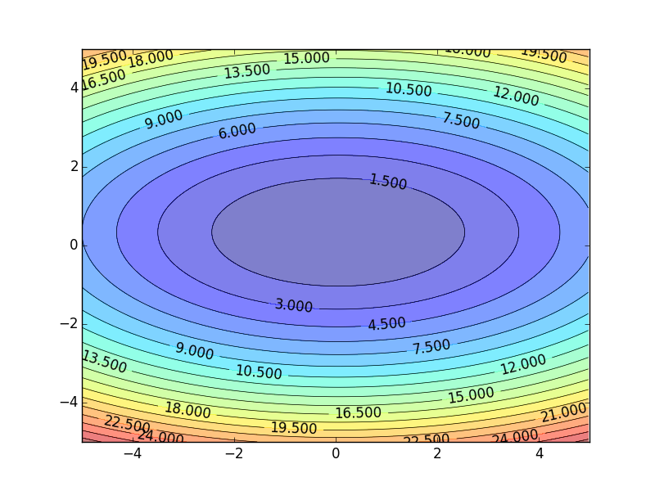
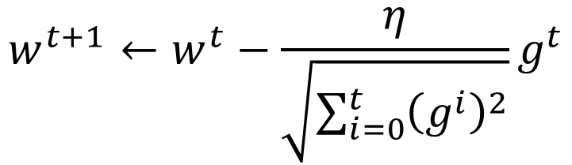


Review
Smaller Learning Rate
$$w_{2}$$
Larger Learning Rate
Adagrad
$$w_{1}$$
$$w^{t+1}←w^{t}−\frac{η}{\sqrt{\sum_{i=0}^{t}{{\left(g^{i}\right)}^{2}}}}g^{t}$$
Use first derivative to estimate second derivative
Notes:
Larger Gradient
Smaller Learning
Rate

Slide 21
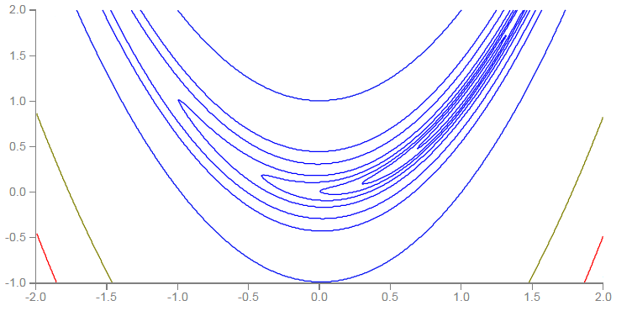


RMSProp
Error Surface can be very complex when training NN.
Smaller Learning Rate
$$w_{2}$$
Larger Learning Rate
$$w_{1}$$

Slide 22

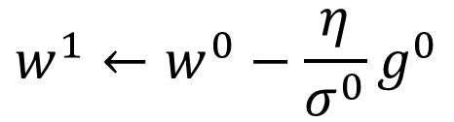

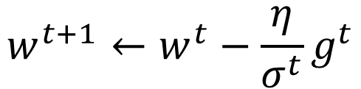

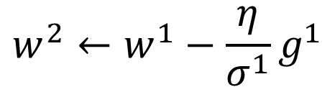


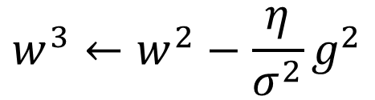
RMSProp
$$w^{1}←w^{0}−\frac{η}{σ^{0}}g^{0}$$
$$σ^{0}=g^{0}$$
$$w^{2}←w^{1}−\frac{η}{σ^{1}}g^{1}$$
$$σ^{1}=\sqrt{{α\left(σ^{0}\right)}^{2}+\left(1−α\right){\left(g^{1}\right)}^{2}}$$
$$w^{3}←w^{2}−\frac{η}{σ^{2}}g^{2}$$
$$σ^{2}=\sqrt{{α\left(σ^{1}\right)}^{2}+\left(1−α\right){\left(g^{2}\right)}^{2}}$$
$$……$$
$$w^{t+1}←w^{t}−\frac{η}{σ^{t}}g^{t}$$
$$σ^{t}=\sqrt{{α\left(σ^{t−1}\right)}^{2}+\left(1−α\right){\left(g^{t}\right)}^{2}}$$
Root Mean Square of the gradients with previous gradients being decayed
Notes:
Root Mean Squares of gradients

Slide 23



Hard to find optimal network parameters
Total
Loss
Very slow at the plateau
Stuck at saddle point
Stuck at local minima
$$∂L∕∂w$$
$$≈0$$
$$∂L∕∂w$$
$$=0$$
$$∂L∕∂w$$
$$=0$$
The value of a network parameter w

Slide 24
In physical world ……
Momentum
How about put this phenomenon in gradient descent?
Notes:
Momentum: 動量

Slide 25





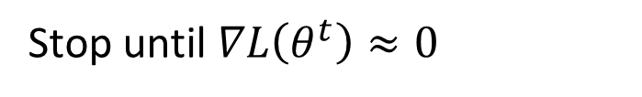
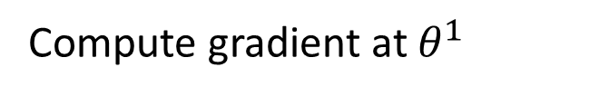




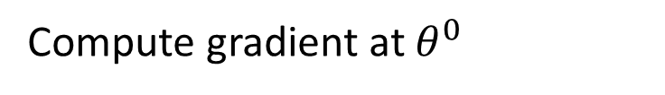


Review: Vanilla Gradient Descent
$$∇L\left(θ^{0}\right)$$
Start at position $θ^{0}$
$$∇L\left(θ^{1}\right)$$
Compute gradient at $θ^{0}$
$$θ^{0}$$
$$θ^{1}$$
Move to $θ^{1}$ = $θ^{0}$ - η$∇L\left(θ^{0}\right)$
$$∇L\left(θ^{2}\right)$$
Compute gradient at $θ^{1}$
$$θ^{2}$$
Gradient
Move to $θ^{2}$ = $θ^{1}$ – η$∇L\left(θ^{1}\right)$
Movement
$$∇L\left(θ^{3}\right)$$
$$θ^{3}$$
……
Stop until $∇L\left(θ^{t}\right)≈0$
Notes:
平凡的；普通的；乏味的

Slide 26


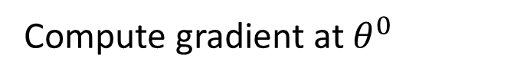
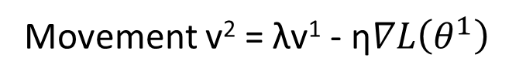

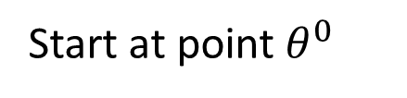

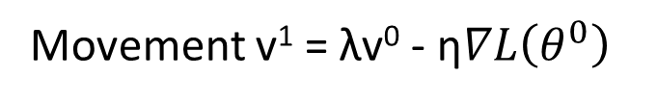

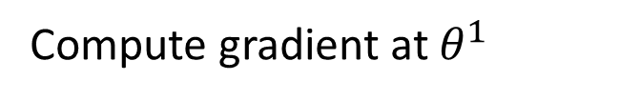


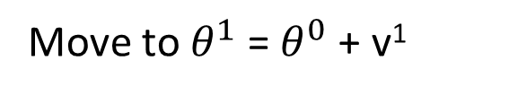


Momentum
Movement: movement of last step minus gradient at present
Start at point $θ^{0}$
Movement v⁰=0
$$∇L\left(θ^{0}\right)$$
Compute gradient at $θ^{0}$
$$∇L\left(θ^{1}\right)$$
$$θ^{0}$$
Movement v¹ = λv⁰ - η$∇L\left(θ^{0}\right)$
$$θ^{1}$$
Move to $θ^{1}$ = $θ^{0}$ + v¹
$$∇L\left(θ^{2}\right)$$
Compute gradient at $θ^{1}$
$$θ^{2}$$
Gradient
Movement v² = λv¹ - η$∇L\left(θ^{1}\right)$
Movement
Move to $θ^{2}$ = $θ^{1}$ + v²
$$θ^{3}$$
$$∇L\left(θ^{3}\right)$$
Movement not just based on gradient, but previous movement.
Movement
of last step

Slide 27
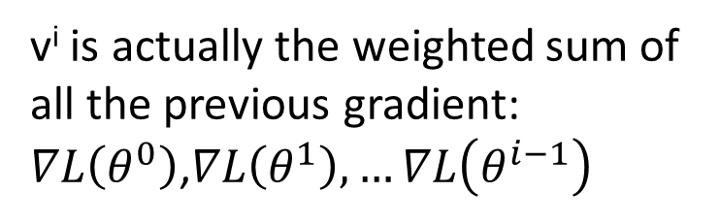
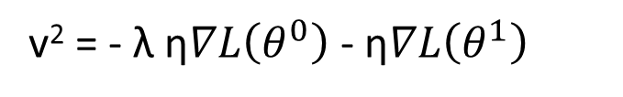
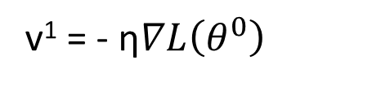
Momentum
Movement: movement of last step minus gradient at present
Start at point $θ^{0}$
Movement v⁰=0
Compute gradient at $θ^{0}$
v^{i} is actually the weighted sum of all the previous gradient: $∇L\left(θ^{0}\right)$,$∇L\left(θ^{1}\right), …∇L\left(θ^{i−1}\right)$
Movement v¹ = λv⁰ - η$∇L\left(θ^{0}\right)$
Move to $θ^{1}$ = $θ^{0}$ + v¹
v⁰ = 0
Compute gradient at $θ^{1}$
v¹ = - η$∇L\left(θ^{0}\right)$
Movement v² = λv¹ - η$∇L\left(θ^{1}\right)$
Move to $θ^{2}$ = $θ^{1}$ + v²
v² = - λ η$∇L\left(θ^{0}\right)$ - η$∇L\left(θ^{1}\right)$
Movement not just based on gradient, but previous movement
……
Notes:
Lambda = 0.9

Slide 28
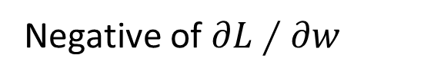
Momentum
Still not guarantee reaching global minima, but give some hope ……
cost
Movement =
Negative of 𝜕𝐿∕𝜕𝑤 + Momentum
Negative of $∂L∕∂w$
Momentum
Real Movement
𝜕𝐿∕𝜕𝑤 = 0
Notes:
What can we see?

Slide 29
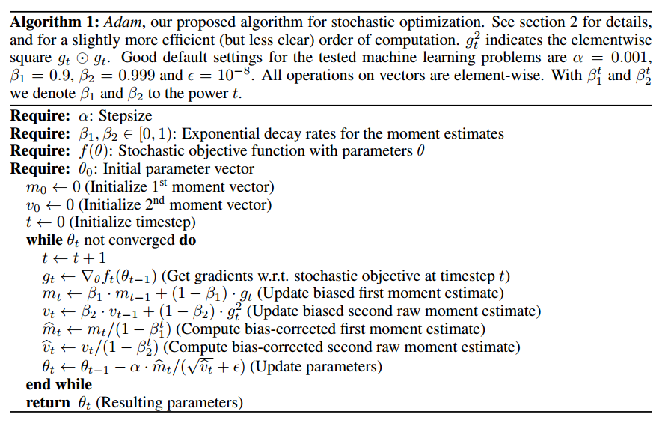
Adam
RMSProp + Momentum
for momentum
for RMSprop
Notes:
http://sebastianruder.com/optimizing-gradient-descent/
http://cs231n.github.io/neural-networks-3/
Original paper: https://arxiv.org/pdf/1412.6980.pdf

Slide 30
Recipe of Deep Learning
Regularization
Early Stopping
Dropout
YES
Good Results on Testing Data?
Adaptive Learning Rate
New activation function
YES
Good Results on Training Data?

Slide 31
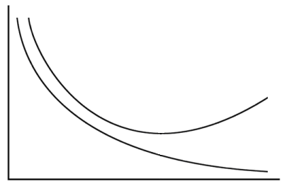
Early Stopping
Total
Loss
Stop at here
Validation set
Testing set
Training set
Epochs
Keras:
http://keras.io/getting-started/faq/#how-can-i-interrupt-training-when-the-validation-loss-isnt-decreasing-anymore
Notes:
Validation set: The data set can used to evaluate your model but not involve in training.
Validation set: seplit from training data
Acturally is difficult
http://deeplearning.net/tutorial/mlp.html#mlp

Slide 32
Recipe of Deep Learning
Regularization
Early Stopping
Dropout
YES
Good Results on Testing Data?
Adaptive Learning Rate
New activation function
YES
Good Results on Training Data?

Slide 33
Regularization
New loss function to be minimized
Find a set of weight not only minimizing original cost but also close to zero
Regularization term
Original loss
(e.g. minimize square error, cross entropy …)
L2 regularization:
(usually not consider biases)
Notes:
L1 is also good, subtle difference

Slide 34
Regularization
L2 regularization:
New loss function to be minimized
Gradient:
Update:
Weight Decay
Closer to zero
Notes:
If p=2, then the regularizer is also called “weight decay”.

Slide 35
Regularization
L1 regularization:
New loss function to be minimized
Update:
Always delete
…… L2
Notes:
If p=2, then the regularizer is also called “weight decay”.

Slide 36
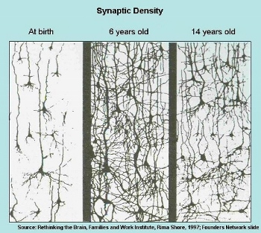
Regularization - Weight Decay
Our brain prunes out the useless link between neurons.
Doing the same thing to machine’s brain improves the performance.
Notes:
人腦會遺忘久沒用的資訊
One kind of regularization

Slide 37
Recipe of Deep Learning
Regularization
Early Stopping
Dropout
YES
Good Results on Testing Data?
Adaptive Learning Rate
New activation function
YES
Good Results on Training Data?

Slide 38
Dropout
Training:
Each time before updating the parameters
Each neuron has p% to dropout
Notes:
Iteration v.s. epoch!!!!!!!!

Slide 39
Dropout
Training:
Thinner!
Each time before updating the parameters
Each neuron has p% to dropout
The structure of the network is changed.
Using the new network for training
For each mini-batch, we resample the dropout neurons
Notes:
Do not worry that someone will not update

Slide 40
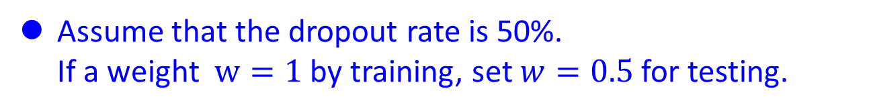
Dropout
Testing:
No dropout
If the dropout rate at training is p%, all the weights times 1-p%
Assume that the dropout rate is 50%.
If a weight $w=1$ by training, set $w=0.5$ for testing.
Notes:
Bias do not have to multiply !!!!!!!!!!!!!!!!!!!!!!!!!!!!!!!!!!!
Reasonable !!!!!!!!!!!!!!!!!!!!

Slide 41


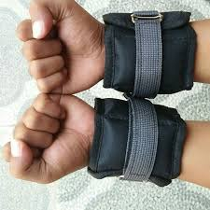
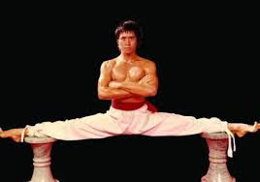
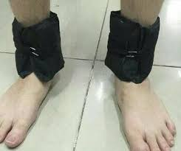
Dropout - Intuitive Reason
Testing
No dropout
(Anda menjadi lebih kuat setelah melepas benda berat)
Training
Dropout (Ikat beban ke kaki)

Slide 42
Dropout - Intuitive Reason
Pasangan saya akan membuat kesalahan, jadi saya harus melakukannya dengan benar
When teams up, if everyone expect the partner will do the work, nothing will be done finally.
However, if you know your partner will dropout, you will do better.
When testing, no one dropout actually, so obtaining good results eventually.
Notes:
Why the weights should multiply p (dropout rate) at testing?

Slide 43
















Dropout - Intuitive Reason
Why the weights should multiply (1-p)% (dropout rate) when testing?
Training of Dropout
Testing of Dropout
Assume dropout rate is 50%
No dropout
Weights from training
$$w_{1}$$
$$0.5×$$
$$w_{1}$$
$$z^{′}≈2z$$
$$w_{2}$$
$$z$$
$$0.5×$$
$$w_{2}$$
$$z^{′}$$
$$w_{3}$$
$$0.5×$$
$$w_{3}$$
$$w_{4}$$
$$0.5×$$
$$w_{4}$$
Weights multiply 1-p%
$$z^{′}≈z$$
Notes:
important

Slide 44
Dropout is a kind of ensemble.
Training Set
Ensemble
Set 1
Set 2
Set 3
Set 4
Network
1
Network
2
Network
3
Network
4
Train a bunch of networks with different structures

Slide 45
Dropout is a kind of ensemble.
Ensemble
Testing data x
Network
1
Network
2
Network
3
Network
4
y₁
y₂
y₃
y₄
average

Slide 46
Dropout is a kind of ensemble.
minibatch
1
minibatch
2
minibatch
3
minibatch
4
Training of Dropout
M neurons
……
2^{M} possible networks
Using one mini-batch to train one network
Some parameters in the network are shared

Slide 47
Dropout is a kind of ensemble.
Testing of Dropout
testing data x
All the weights multiply 1-p%
……
y₁
y₂
y₃
?????
average
≈
y
Notes:
0,0 -> 0
1,0 -> 1
0,-1 -> -2
1,-1 -> -1
½, -1/2 -> -0.5
1,2
Geometric Mean?

Slide 48


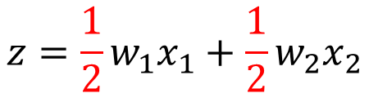
Testing of Dropout
x₁
x₂
x₁
x₂
x₁
x₂
w₁
w₂
w₁
w₂
w₁
w₂
z=w₁x₁+w₂x₂
z=w₁x₁+w₂x₂
z=w₂x₂
x₁
x₂
x₁
x₂
x₁
x₂
$$\frac{1}{2}$$
$$\frac{1}{2}$$
w₁
w₁
w₁
w₂
w₂
w₂
$$z=\frac{1}{2}w_{1}x_{1}+\frac{1}{2}w_{2}x_{2}$$
z=w₁x₁
z=0

Slide 49
Recipe of Deep Learning
YES
Step 1: define a set of function
Step 2: goodness of function
Step 3: pick the best function
NO
Good Results on Testing Data?
Overfitting!
YES
NO
Good Results on Training Data?
Neural Network
Notes:
Other methods do not emphasize this.

Slide 50




Try another task
Politic
“stock” in document
Machine
Economy
Education
“president” in document
Politic
Economy
Education
http://top-breaking-news.com/

Slide 51
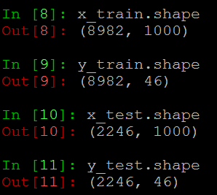
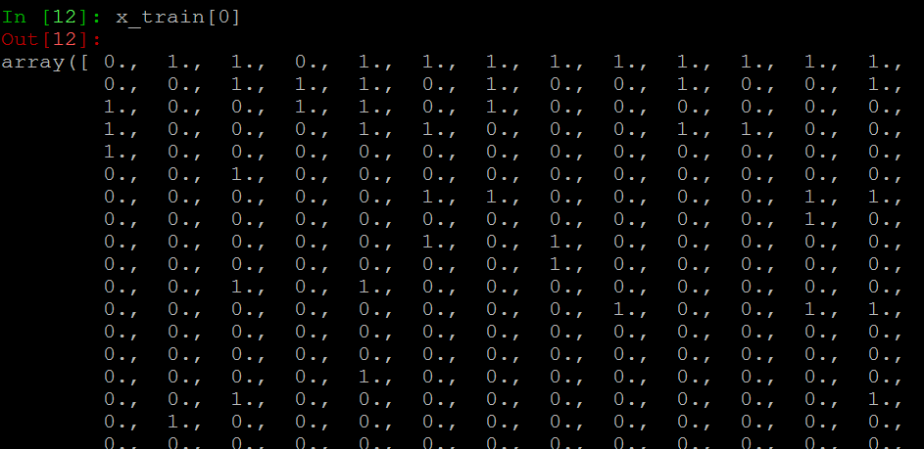
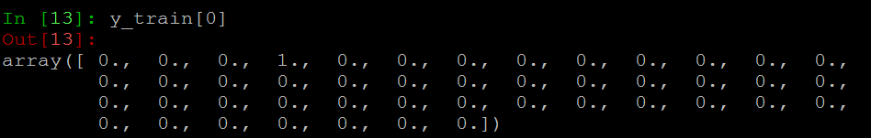
Try another task

Slide 52
Thank you!
PDS
SDN
NFV
Computer Vision
Thank you For being a great class!
https://github.com/siagianp
https://github.com/amelcharolinesgn2/IoT_simulator-mqtt-NodeRed
https://www.youtube.com/@AmelOline/videos
Notes:
https://medium.com/buildpiper/simplifying-containerization-with-docker-run-command-2f74e114f42a
https://github.com/IBA-Group-IT/IoT-data-simulator
https://www.bevywise.com/blog/docker-mqtt-broker-easy-service-manageability/

